Slide 1
Simulation
Stochastic modeling

Slide 2
Random objects
Random objects and base generator
Random events
Random variables
Random processes
Random point processes
BG
Transformation
α
X

Slide 3
Continuous RV
methods of generation

Slide 4
Continuous RV
Let ξ be a continuous random variable
is a cumulative distribution function (CDF)
is a probability density function (PDF)

Slide 5
Uniform RV
Generator:

Slide 6

Straightforward method (inverse function)
Let $ξ=φ\left(α\right)$
$α=φ^{−1}(x)$
Let $φ(∙)↑$

Slide 7
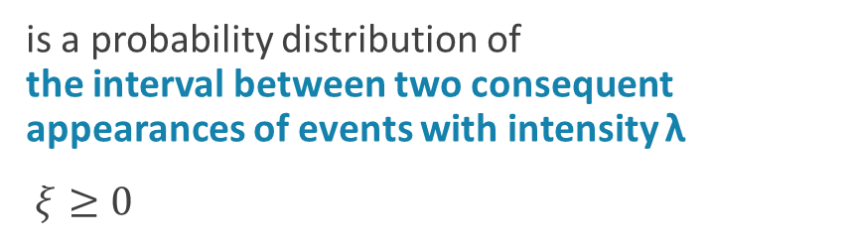
Exponential distribution
is a probability distribution of the interval between two consequent appearances of events with intensity λ
$ξ≥0$
generator:

Slide 8
RV given by histogram
Usually obtained from practice (experiments)
is equal to area
Total area:

Slide 9
RV given by histogram
is equal to area
Algorithm:

Slide 10
RV given by histogram
no
yes

Slide 11
Superposition method
For the case where
Algorithm:
Generate discrete RV β with probability mass function
Generate continuous RV ξ with PDF

Slide 12
Hyperexponential distribution
models RV that is a mix of exponential RVs traditionally, is used as an approximation for distributions with coefficient of variation CV > 1 (CV = σ / a)
Algorithm:
Generate discrete RV i with probability mass function π_{i} , i = 1, 2, …, n
Generate exponential RV ξ with intensity λ_{i} :

Slide 13
Rejection method
is used when PDF is given in the form
Theorem. If two-dimensional RV (ξ, η) has PDF
then ξ has PDF

Slide 14
Rejection method
E.g., let
and
M
G₁
Algorithm:
a
0
b
Generate two independent uniform RV:
If
then ξ is a result, else repeat from step 1.

Slide 15
Continuous RV
Special methods of modeling

Slide 16
Gaussian (normal) distribution
is a probability distribution traditionally used for modeling of some continuous variable which takes values nearby given mean
a is the mean (expectation)
σ is the standard deviation
σ² is the variance

Slide 17
Gaussian (normal) distribution
generator?
Standard normal RV:
Normal RV N(a, σ²):

Slide 18
Standard normal distribution
1-2. Generators based on central limit theorem (Summing up method)
Idea: let
be some RV identically distributed
Generators:
then
n = 12:
Let
2.
then

Slide 19
Standard normal distribution
3. Generator based on Box-Muller transform

Slide 20
Statistical processing for continuous RVs
1. When you model some random variable, you obtain its values (sample):
2.234, 0.167, 3.1, 3.47, 1.104, -0.345, -1.241, 2.133, -1.02, -0.546, 2.654, 1.13, -1.987, -2.02, 1.55, 3.14
2. Prepare grid of intervals:
a) (-5; -4] (-4; -3] (-3; -2] (-2; -1] (-1; 0] (0; 1] (1; 2] (2; 3] (3; 4] (4; 5]
b) min = -2.02; max = 3.47
-> (-3; -2] (-2; -1] (-1; 0] (0; 1] (1; 2] (2; 3] (3; 4]
-> (max-min) = 5.49
-> we want to have k = 5 intervals: (max-min)/5 = 5.49/5 = 1,098
-> [-2.02; -1.471] (-0.922; 0.176] (0.176; 1.274] (1.274; 2.372] (2.372; 3.47]
(in practice: take 5.49+0.01 instead of 5.49 to slightly expand the boundaries)
-> choose k using a special method

Slide 21
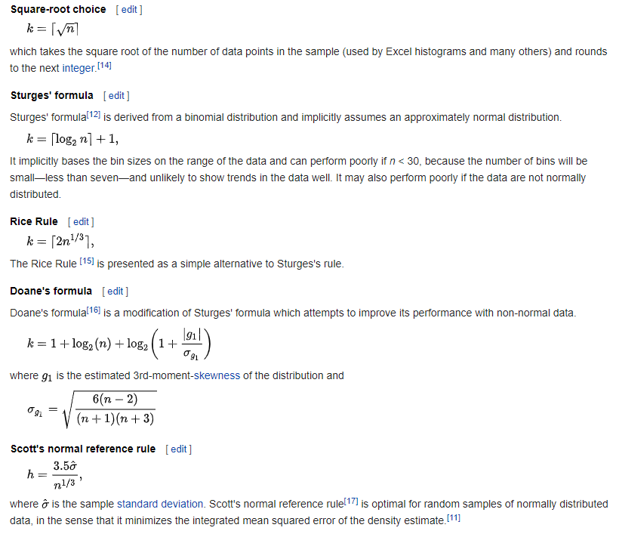
Special methods of choosing the number of intervals

Slide 22
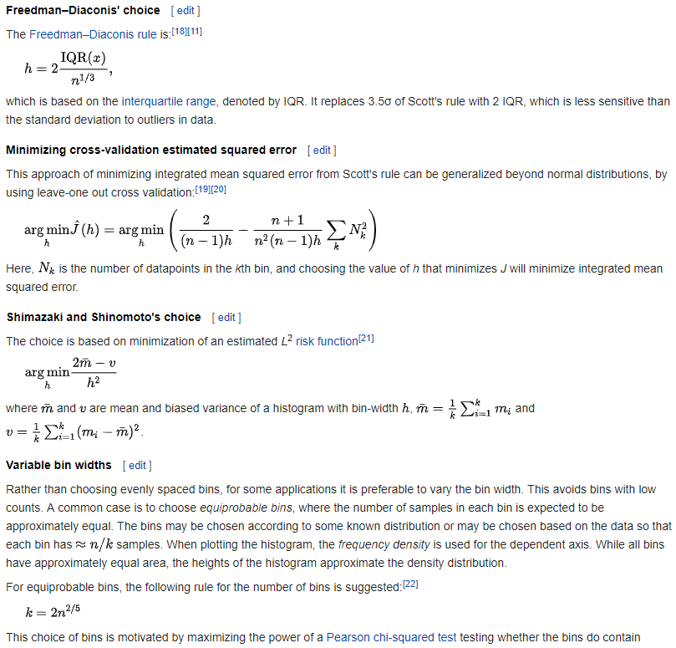
Special methods of choosing the number of intervals

Slide 23
Constructing of histogram
3. Count how many times values have matched to each interval. Write the result into the table:
Interval | (-3; -2] | (-2; -1] | (-1; 0] | (0; 1] | (1; 2] | (2; 3] | (3; 4]
Count | 1 | 3 | 2 | 1 | 3 | 3 | 3
4. Divide all counts by the total number of values (sample size). Rewrite the table:
Values | (-3; -2] | (-2; -1] | (-1; 0] | (0; 1] | (1; 2] | (2; 3] | (3; 4]
Frequency | 0.0625 | 0.1875 | 0.125 | 0.0625 | 0.1875 | 0.1875 | 0.1875

Slide 24
Histogram
Values | (-3; -2] | (-2; -1] | (-1; 0] | (0; 1] | (1; 2] | (2; 3] | (3; 4]
Frequency | 0.0625 | 0.1875 | 0.125 | 0.0625 | 0.1875 | 0.1875 | 0.1875
5. Draw histogram graph:

Slide 25
Statistics for continuous distribution
Chi-squared test
Empiric average and variance

Slide 26
Laboratory #14
Assignment:
Simulate normal RV using any method. Perform statistics processing of the results: a) Build histogram; b) Estimate accuracy for sample size equal to 10, 100, 1000, 10000.
Mean
Variance
Average: 2.897 (error = 8%)
Variance: 2.072 (error = 9%)
Sample size
Start
Chi-squared: 13.51 > 11.07
is true

Slide 27
Gamma distribution
is widely used in applied probability
models arbitrary distributions in analytical models
can be used as approximation of some distribution with non-negative values
allows easy customization of parameters
k and α are shape parameters
θ and β are scale (rate) parameters

Slide 28
Gamma distribution

Slide 29
Gamma distribution with one parameter
scale = 1
Properties:
if α is integer then
if α = 1, it coincides with exponential distribution with parameter λ = 1

Slide 30
Gamma distribution generator
1.
2. If δ > 0 then generate
3. If d > 0 then generate d exponential RV
4. Sum up all generated values and divide sum on β

Slide 31
Generator for gamma distribution with one parameter
where
1.
2. Generate two base RV:
3. If
then
else
4. If
then go to step 2
else take η₁ as a result

